Slide 1
Data Processing and Presentation
Name:
Professor:
Course:
Date:

Slide 2
Prevention of Carbon Emissions from 250 Yonge Street Building, Toronto, Ontario, Canada
Buildings and the construction process contribute approximately 36% of global energy consumption.
Also they contribute 39% of energy-related carbon emissions.
Active energy contributes 28% of total emissions annually.
Increased carbon emissions associated with urbanization
Notes:
Buildings and the construction process contribute approximately 36% of the global energy consumption and 39% of energy-related carbon emissions (Dakwale&Ralegaonkar, 2011). Global emissions from the buildings are linked to two processes:
Operational carbon from day to day use of energy, heating, and lighting. Active energy contributes to 28% of the total emissions per year (Dakwale&Ralegaonkar, 2011). The energy produced in the construction process through materials, construction processes, and transportation, influences greenhouse gas emissions.Accounting the carbon emission footprint from buildings will ensure that the environmental engineering field enhances the environment (Huang et al., 2017). Understanding the facility's carbon emission will ensure that solutions are developed and executed to protect the environment. The presence of urbanization in different countries has contributed to an increased rate of greenhouse emissions from buildings.

Slide 3
Effects of carbon emissions from buildings
Increased global warming
Affected ecosystem
Rise of tropical storms
Notes:
These emissions are linked to various impacts that affect the habitat of species around the globe. One of the significant effects is the increased global warming effect. The ecosystem is not effective in regulating heat as the ozone layer is affected. Also, the rise in tropical storms and floods has been influenced by greenhouse gas emissions (Huang et al., 2017).

Slide 4
Site location
The 250 Yonge street building is a 35-storey building located in Yonge Street.
100% complete.
Located in Toronto ON M5B2L7.
Façade material is aluminium , blue in color.
Centrally controlled air conditioning.
It has 151 meters tall, 35 floors, and 16 elevators.
35% of carbon emissions from the site are linked to water supply, heating, and electrical.
Notes:
The Site is a 35-storey building which is located in Yonge Street. The type of structure is a skyscraper, which is 100% completed. The facade material used in the Site is aluminum, and the color is blue (250 Yonge Street, Toronto Greenhouse Gas Inventory Report, 2013). The postmodern architectural style is evident in the building, and a forced-air heating strategy is used. The air conditioning strategy for the Site is centrally controlled. The height of the Site is 151 meters with 16 elevators and 35 floors above the ground. The Site was constructed in 1991; however, it is still linked to increased greenhouse gas emissions, including carbon. The Site emits up to 35% of carbon from the energy released from the activities such as water supply, heating, and electrical.

Slide 5
Problem
Buildings are associated with increased environmental pollution.
Government regulations aimed at having zero carbon emissions by 2030.
Toronto accounts for 505 of total emissions of greenhouse gases.
Continued carbon emissions expected due to design of the structures.
The 250 Yonge Street building is one of the buildings that emit large volumes of greenhouse gases.
Notes:
The primary issue raised in Canada is the increased rate of environmental pollution from buildings in various locations. The government developed objectives to ensure decreased greenhouse gas emissions from the buildings to zero levels by 2030. However, researchers show that emissions are still high, which is an obstacle to achieving the 2030 objective.
Toronto, the largest city in Canada, accounts for more than 50% of the total emissions of greenhouse gases from edifices and the environmental engineering experts provide that there are no other safe options that could be adopted in building structure especially in this era of urbanization (Mohareb&Mohareb, 2014). However, the administration still insists that by 2030 the goal of zero emissions must be achieved. Looking at the structures developed in Toronto, the expulsion of carbon and other greenhouse gases will continue for many decades; therefore, there is a need for developing strategies that will ensure solutions to the challenge. The Site is one of the known buildings that emit carbon. The building's administration has been working to find the solution to the challenge following complaints from different stakes (250 Yonge Street, Toronto Greenhouse Gas Inventory Report, 2013)

Slide 6
Effects of emissions from the 250 Yonge Street building
Adverse climate changes
Storms
Increased temperatures
Development of asthma, cardiac diseases, and allergies
Notes:
The emission of carbon from the Site has contributed to various challenges in the location. The impacts include adverse climatic changes such as storms and increased temperature. Also, increased health issues among the Site population, such as malignancies, asthma, cardiac diseases, and allergies, have been reported. Therefore, carbon emissions from the Site need to be solved.

Slide 7
Scope
Evaluate the site conditions related to carbon emissions and targets provided by 2030.
Present solutions to mitigate carbon emissions
Solutions aimed at alleviating adverse effects associated with carbon emissions.
Use industry best practices for retrofitting.
Report provides suggestions only.
Notes:
This report's scope will evaluate the Site conditions related to carbon emissions and the target provided by 2030. Solutions to mitigate the carbon emissions will be presented and assessed in cost, efficiency, and carbon reduction. The report will provide solutions that establish the prevention of carbon emissions from the Site which will prevent adverse effects linked to the emission.
This report will incorporate industry best practices for retrofitting an existing building to increase its building envelope's efficiency. Scholars' best practices will be embraced and included in the solutions to suggest what the Site needs to change or incorporate to enhance effective control of carbon emissions.
Costs associated with this report will be based on material only and not labor.The report will provide the study of carbon emissions that are only related to the Site. The topics to be covered in the report includes the solutions that will enhance the prevention of carbon emissions from the building. The report only provides suggestions for the solutions without the implementation process. The concepts that will be used for the report include insulation, heat, and light control which will provide solutions for the carbon emissions challenge in the Site. For the solutions to be established effectively, the use of evidenced-based resolutions will be enhanced. In the establishment of this report, the main constraint expected is time in comparison with the scope. The factor of the cost-effectiveness of the scope is dependent on the time used.

Slide 8
Scope cont’
Explore factors that enhance emissions from the site.
Provide solutions to minimize environmental pollution.
Site analysis done through observations and information from site stakeholders.
Notes:
This report explores the factors that enhance the emission of gases from the Site and provide solutions that will be developed to ensure that the prevention of environmental pollution is enhanced. The report explores the Site through observation and accessing information from the stakes of the building. This involves gaining an understating of how the building was constructed and the strategies that are used to control operational energy. The study only concentrates on the Site for two weeks. The expected outcome of the report is to enhance solutions that will diminish carbon emissions at the Site.

Slide 9
Types of data
MTO specification standards on construction of buildings.
Use materials, which limit CO2 emissions.
Asphalt used for its durability, aesthetic value, lower cost, and moisture protection from the sun.
Notes:
One of the key considerations that the Ministry of Transportation Ontario (MTO) has put in place is identification of less costly materials that can be used to help in the alleviation of CO2 emissions. MTO develops standards that are adhered to by contractors to enhance the construction of buildings, roads, and other infrastructure, with the aim of having zero carbon emissions by 2030. Hertwich et al., (2019) argues that it is necessary to use efficient materials, which are less costly and capable of minimizing carbon dioxide emissions. The materials that will be used to ensure that the 250 Yonge Street Building has limited emissions will be based on asphalt, rather than concrete. MTO has set specific standards, which are used in the process of modifying base requirements. Items that involve the use of concrete in the construction of this building include pavements and concrete base, concrete barriers, structures, overlays, and patches. For the case of this building, asphalt will be used because of its durability, aesthetic value, cost, moisture protection from the sun.

Slide 10
Types of data cont’
Materials used
Tars
Stone mastic asphalt
Coal tar
Pitch
Crashed gravel
Notes:
Materials that will be used for the base construction in asphalt include tars, stone mastic asphalt, coal tar, and pitch. Materials that will be used for the base of this project are crushed gravel like granite c-5 and limestone c-5. The soil in this site is not loose, thus using these materials will offer a stronger foundation.
Stone mastic asphalt is composed of bitumen, calcareous fines, sand, chippings, and asphalt powder. This material is chosen because it can be worked on when it is hot, has a good wear resistance, and it is water proof. Coal tar will be produced through plasticization of coal, coal tar pitch, and distillates (Diaz et al., 2016).
To cover the base of the building (812,6381 sq. feet), the following cost estimates were made.
Concrete driveway removal will cost $6 per square foot
Subgrade layer: 3-8 inches of aggregate material for asphalt bed. Manual installation and grading will cost $1.35 per square foot.
Base layer based on MTO standards: 2 inches base layer and 1-inch top coat. Estimated cost is $1.40 and $1.10 per square feet respectively.
Sealing cost after curing is $0.75 per square foot.
Cost estimates for asphalt base was obtained from best industry practices and MTO.
Calculations for area and perimeter

Slide 11
Types of data cont’
Sections of the site (percentage of the total area)
Financial services section – 67%
Legal services section – 9%
Real estate and infrastructure section - 8%
Notes:
The building has 812638 sq. ft.
Ventilation – there are 2 makeup air units, a variable air volume floor air distribution and variable fan drives.
There are 4 feet lighting fixtures with a generic electric lighting control.
Of the total 812638 sq feet, the area is divided into 8 sections
financial services section
legal services section
Real estate and infrastructure
Percentage of the total area for each section
67%
9%
8%
Area of each section in sq. ft
544467.46 sq.ft
73137.42 sq.ft
65011.04 sq.ft

Slide 12
Types of data cont’
Fitness center section – 5%
Government section – 4%
Medical services section – 4%
IT services section – 3%
Others - 1%
Notes:
fitness center section
government section
Medical services section
IT services section
Other sections
Percentage of the total area of each section
5%
4%
4%
3%
1%
Area f each section in sq.ft
40631.9 sq.ft
32505.52 sq.ft
32505.52 sq.ft
24397.14 sq.ft
8126.38 sq.ft

Slide 13
Types of data’
Ontario building code
Engineering blueprints
Notes:
Ontario building code. In this project, construction and demolition code and property standards will be addressed as proposed by the Building Code Act, 1992, S.O. 1992, c. 23.

Slide 14
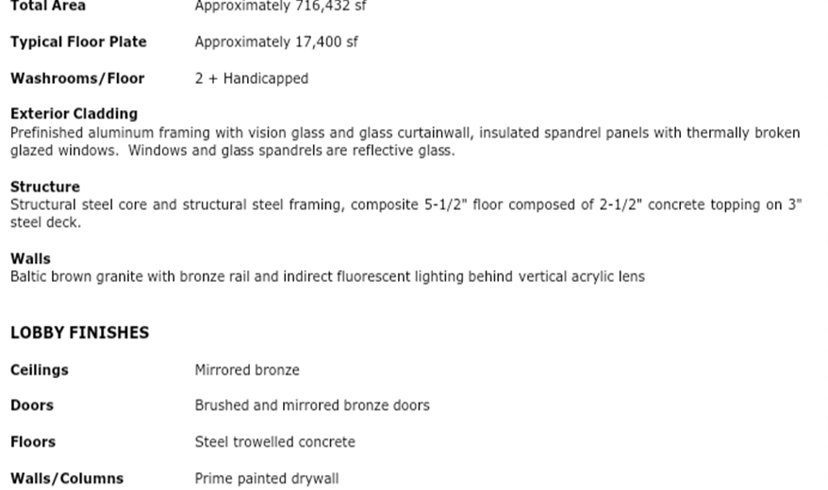
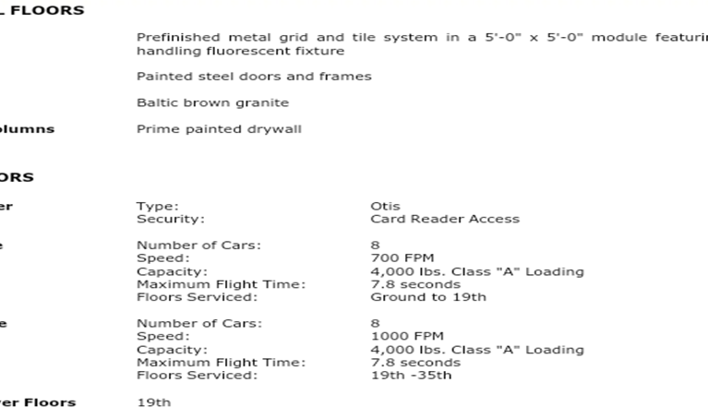
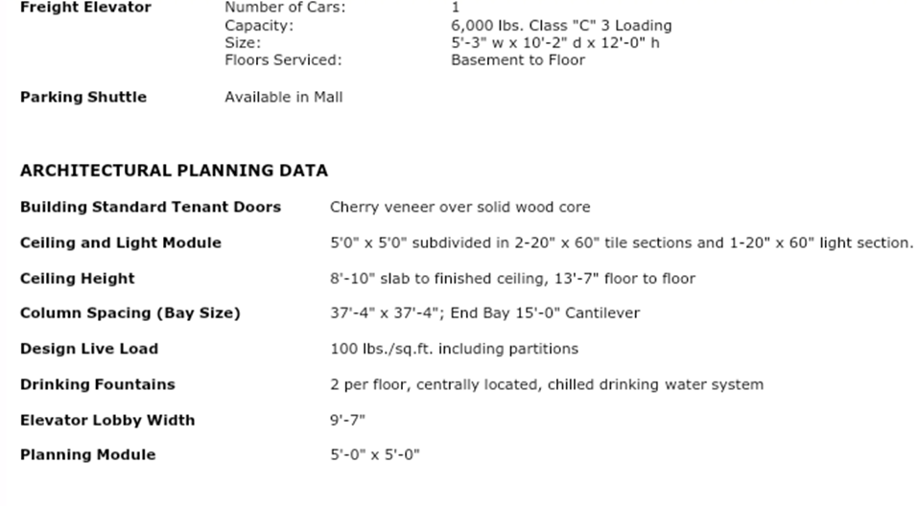
Engineering blueprints

Slide 15
Sources of data
• 250 Yonge Street, Toronto Greenhouse Gas Inventory Report. (, 2013). Retrieved 7 October 2020, from https://www.csaregistries.ca/files/projects/2301-2780_GHGReport_20110401_201203311.pdf.
• Dakwale, V., &Ralegaonkar, R. (2011). Review of carbon emission through buildings: threats, causes, and solutions: Table 1. International Journal of Low-Carbon Technologies, 7(2), 143-148. https://doi.org/10.1093/ijlct/ctr032
• Diaz, R. O., Montanez, A., & Cuentas, J. (2016). Coal tar, material used in soil improvement for use in road engineering. In J. Phys. Conf Ser (687, p. 12045).
• Hertwich, E., Ali, S., Ciacci, L., Fishman, T., Heeren, N., &Masanet, E. et al. (2019). Material efficiency strategies reduce greenhouse gas emissions associated with buildings, vehicles, and electronics—a review. Environmental Research Letters, 14(4), 043004. https://doi.org/10.1088/1748-9326/ab0fe3
• Huang, W., Li, F., Cui, S., Li, F., Huang, L., & Lin, J. (2017). Carbon Footprint and Carbon Emission Reduction of Urban Buildings: A Case in Xiamen City, China. Procedia Engineering, 198, 1007-1017. https://doi.org/10.1016/j.proeng.2017.07.146
• Mohareb, E., &Mohareb, A. (2014). A comparison of greenhouse gas emissions in the residential sector of major Canadian cities. Canadian Journal of Civil Engineering, 41(4), 285-293.https://doi.org/10.1139/cjce-2013-0465

Slide 16
Data storage
Excel sheets
Appendix
Notes:
Data on the cost of materials that will be used for this project will be stored using excel sheet, tables, and in the appendix. Excel sheets will be used to categorize all materials used, where they will be sourced from, and their costs. Using excel sheets to store the processed data will ensure that it is clear and arranged in a logical order. The engineering blueprints data will be presented in the body of the report and in the appendix. Storing this data in the body will ensure that all explanations and details are discussed. Also, using the appendix will ensure that there is a logical flow of information.

Slide 17
Data processing
Cost of materials will be analyzed
Data presented in engineering blueprints will be analyzed
Notes:
The cost of materials for this project will need to be analyzed to determine the total costs and address any issues of uncertainty.
Data of the blueprints will also be analyzed to ensure that the project is well mapped and no details are overlooked.

Slide 18
Types of data analysis
Descriptive analysis
Diagnostic analysis
Prescriptive analysis
Notes:
For this project to be a success, three types of data analysis will be used.
Descriptive analysis: It will show the performance of the building using the current architectural design and how the design has led to increased emissions.
Diagnostic analysis: Will be used to determine the causes of increased emissions from the building.
Prescriptive analysis: will be performed to provide insights about the approaches of preventing carbon emissions from 250 Yonge Street building.

Slide 19
Data analysis 1
Descriptive analysis - It will show the performance of the building using the current architectural design and how the design has led to increased emissions.
Notes:
The descriptive analysis will be conducted using previous data on the rate of emissions, the cost of maintaining the building, and its impact to the local population. This analysis will be performed using data from MTO. A descriptive analysis will be performed to determine how the architectural design and the materials used have contributed to an increase in carbon emissions.

Slide 20
Data analysis 2
Diagnostic analysis - Will be used to determine the causes of increased emissions from the building.
Notes:
A diagnostic analysis will be performed to determine why the building emits up to 35% of carbon emissions in the site. The first step will be to analyze the blueprints to ascertain how water will be supplied in the building, how heating and cooling will be regulated, and how electrical systems will be installed. An analysis of the façade material will be performed to determine how aluminium contributes towards increased emissions. The effects of using a centrally controlled air conditioning and a forced air heating type will be addressed. Also, the height from floor to floor and floor to ceiling will be analyzed to estimate its contributions to the current problem.

Slide 21
Data analysis 3
Prescriptive analysis - will be performed to provide insights about the approaches of preventing carbon emissions from 250 Yonge Street building.
Notes:
A prescriptive analysis will be conducted to provide the most viable solutions to alleviate C02 emissions. This analysis will basically rely on artificial intelligence (AI) systems that will communicate informed decisions based on the insights obtained from the descriptive and diagnostic analysis.

Slide 22
Presentation of results
Use of tables
Graphs
Statistics
Notes:
After analysis, the results will be presented using tables, graphs, and statistics. Tables will be used to show costs of materials used and the rate of carbon emissions from different sections of the building. Graphs will be used to show carbon emission trends based on the existing design and the proposed design. Lastly, statistics will be used to show cost estimates of materials and the expected levels of carbon emissions.

Slide 23
References
250 Yonge Street, Toronto Greenhouse Gas Inventory Report. (, 2013). Retrieved 7 October 2020, from https://www.csaregistries.ca/files/projects/2301-2780_GHGReport_20110401_201203311.pdf.
Dakwale, V., &Ralegaonkar, R. (2011). Review of carbon emission through buildings: threats, causes, and solutions: Table 1. International Journal of Low-Carbon Technologies, 7(2), 143-148. https://doi.org/10.1093/ijlct/ctr032
Diaz, R. O., Montanez, A., & Cuentas, J. (2016). Coal tar, material used in soil improvement for use in road engineering. In J. Phys. Conf Ser (687, p. 12045).
Hertwich, E., Ali, S., Ciacci, L., Fishman, T., Heeren, N., &Masanet, E. et al. (2019). Material efficiency strategies reduce greenhouse gas emissions associated with buildings, vehicles, and electronics—a review. Environmental Research Letters, 14(4), 043004. https://doi.org/10.1088/1748-9326/ab0fe3
Huang, W., Li, F., Cui, S., Li, F., Huang, L., & Lin, J. (2017). Carbon Footprint and Carbon Emission Reduction of Urban Buildings: A Case in Xiamen City, China. Procedia Engineering, 198, 1007-1017. https://doi.org/10.1016/j.proeng.2017.07.146
Mohareb, E., &Mohareb, A. (2014). A comparison of greenhouse gas emissions in the residential sector of major Canadian cities. Canadian Journal of Civil Engineering, 41(4), 285-293.https://doi.org/10.1139/cjce-2013-0465

